Slide 1
DPM Final Project – Week 1
TEAM 11

Slide 2
Team Breakdown
Bryan Jay
Project Manager
Luka Jurisic
Documentation Manager
Enan Ashaduzzamane
Hardware Leader
Team 11
Volen Mihaylov
Head Engineer
Patrick Ghazal
Software Leader
Tianyi Zou
Testing Manager

Slide 3
Gantt Chart
Refer to Application

Slide 4
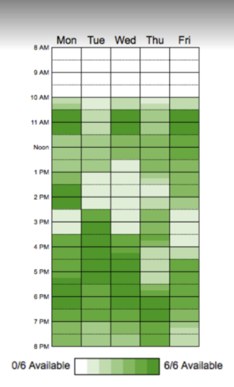
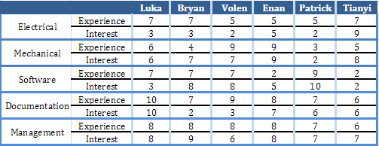
Capabilities
Scale on 1-10

Slide 5
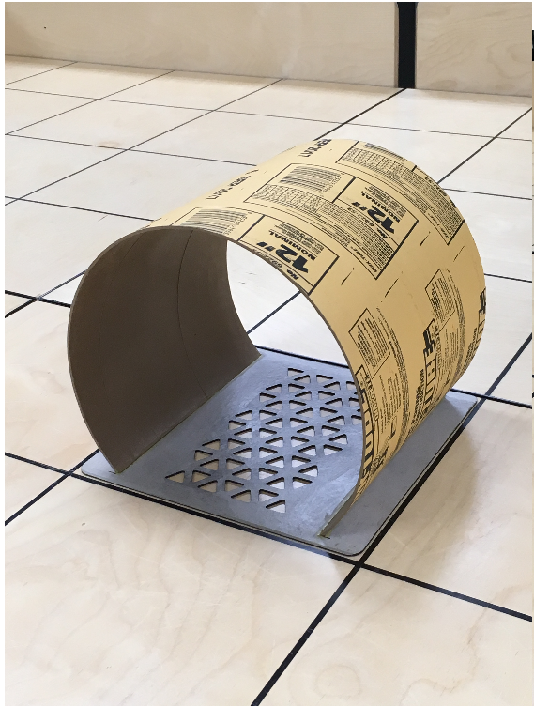
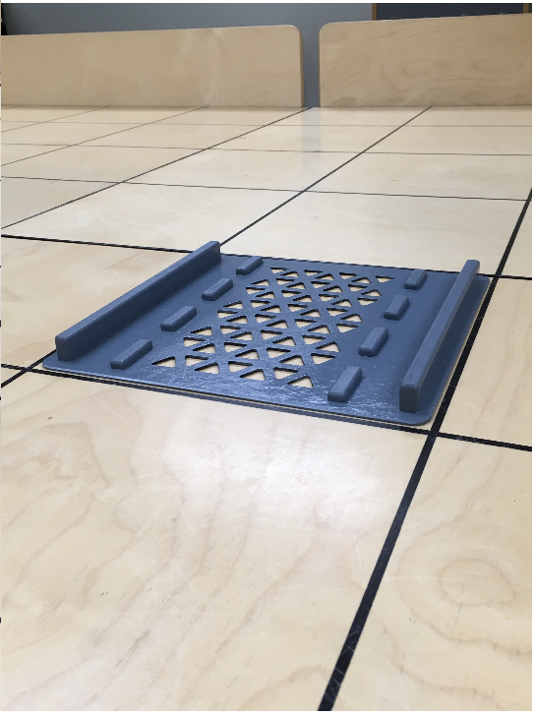
Requirements
Rules:
Prohibited to enter the water
Search opposing team’s area & Capture the block within given time frame
Traverse both the bridge and tunnel

Slide 6
Requirements
Robot Performance Breakdown:
Receive Game Parameters
Traverse Proper Obstacle
Localize
Navigate
Navigate to Search Area
Return
Capture
Search Area

Slide 7
Constraints
Hardware (Per EV3 Kit):
4 input ports to allow sensor integration
4 output ports to allow servo motor connection
2 Large EV3 Motors
1 Small EV3 Motor
1 NXT Brick
1 US Sensor
1 Battery
1 Light Sensor

Slide 8
Constraints
Software:
Multithreading and Overloading
Wheel slippage due to set speeds
Environmental:
Must be capable to traverse a bridge and tunnel
Ambient lighting
Debris on the track

Slide 9
Systems
Reusing Implemented Code from previous labs
Main Limitations
Ultrasonic Sensor
Non-Ideal, Unreliable
Color Sensor
Affected by ambient lighting
NXT Brick
48MHz processor, 256KB of flash memory, 64KB of ram
Cautious with treading and overloading

Slide 10

Tools
Google Drive
Eclipse IDE
GitHub
Draw.io
Slack
Gantt Project
Dropbox
Lego Digital Designer

Slide 11
Lab 5 Breakdown
Searched and Localize
Similar Navigation
Similar Localization
Building Block for final Project

Slide 12
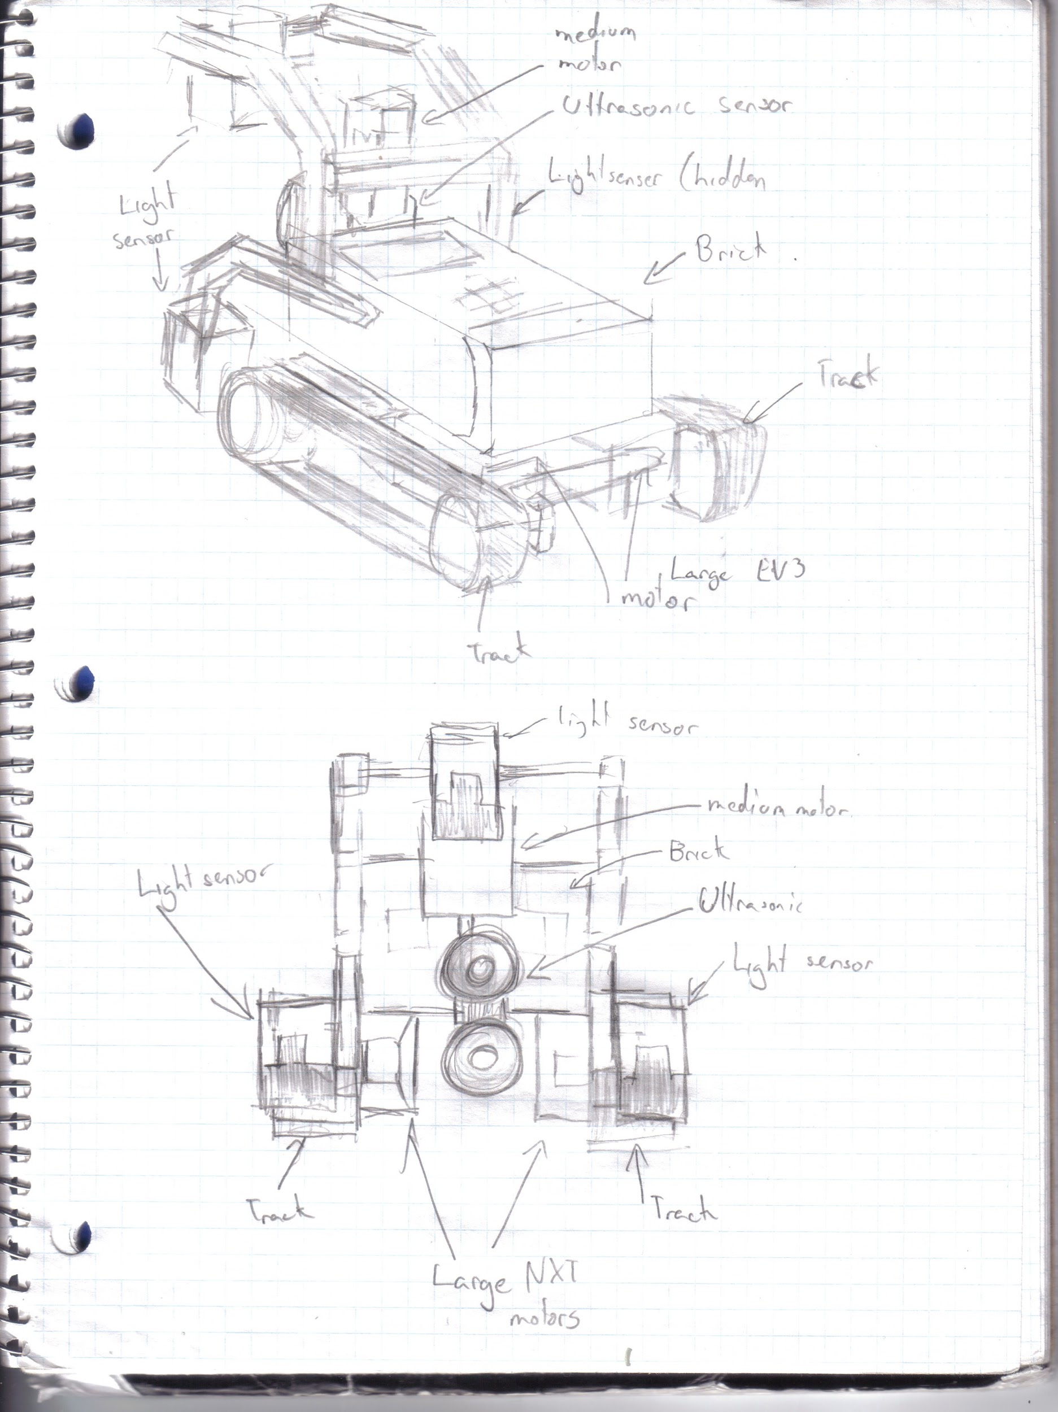
Preliminary Hardware Design #1
Key Features
Track Belt used for better traction.
Two light sensors in front of both corners of the robot. Allows for better odometer correction.
Variable Ultrasonic sensor for detection of blocks on multiple sides of the robot.
Colour detecting light sensor is always 11 cm off the ground allowing for more consistent readings.
Key Parts
3 light sensors
1 ultrasonic sensor
2 large EV3 motors
1 medium EV3 motor

Slide 13
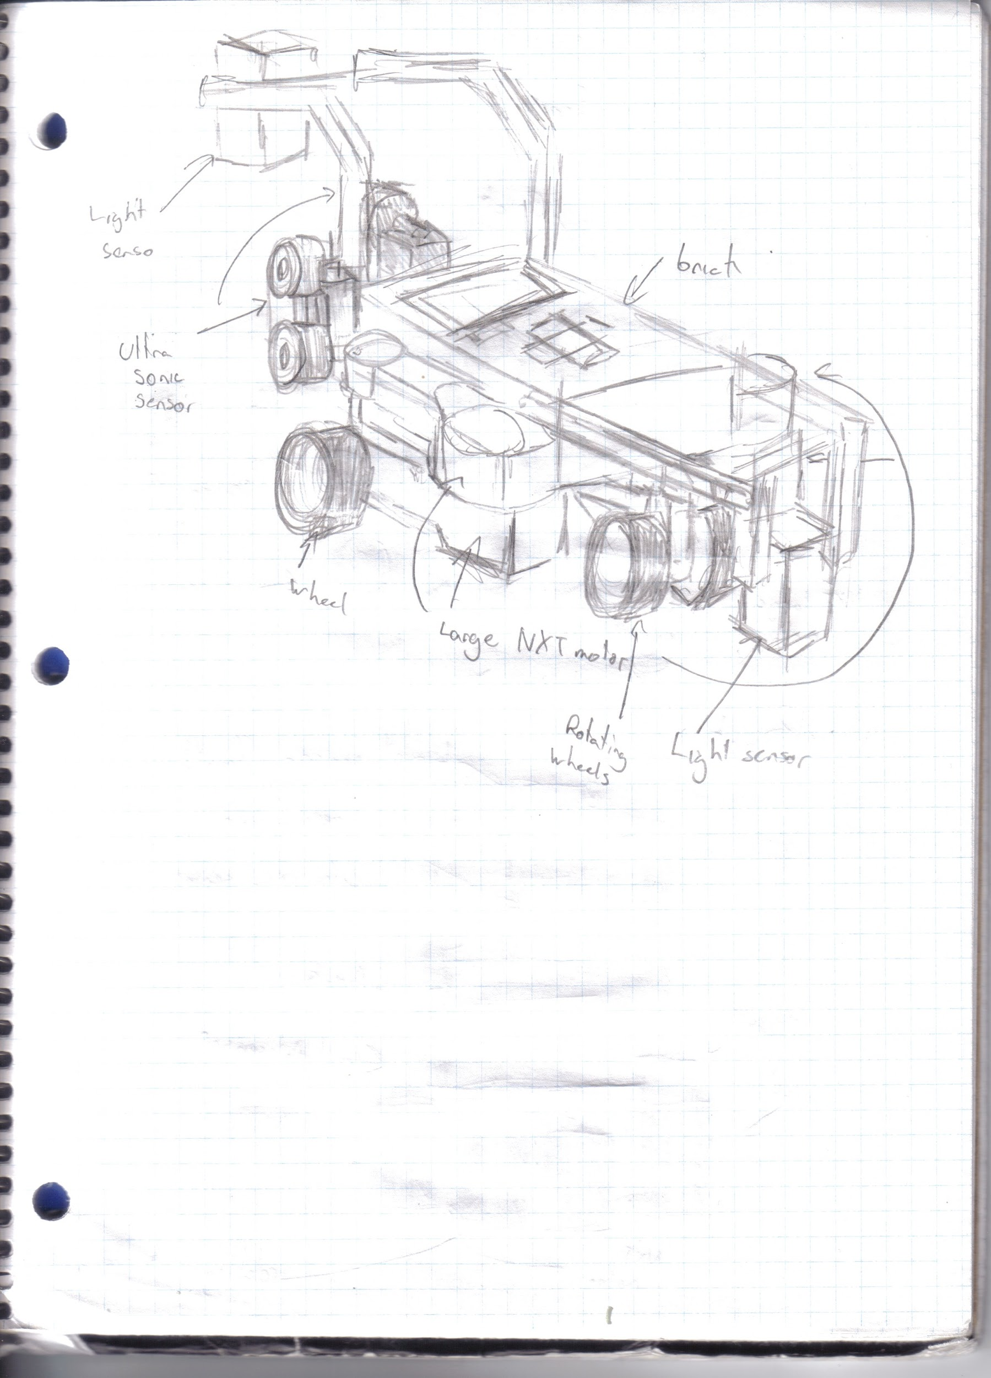
Preliminary Hardware Design #2
Key Features
Used a variable track system allowing the robot to avoid bumps from the bridge
Colour detecting light sensor is always 11 cm off the ground allowing for more consistent readings.
Key Parts
2 light sensors
4 large EV3 motors
2 ultrasonic sensors

Slide 14
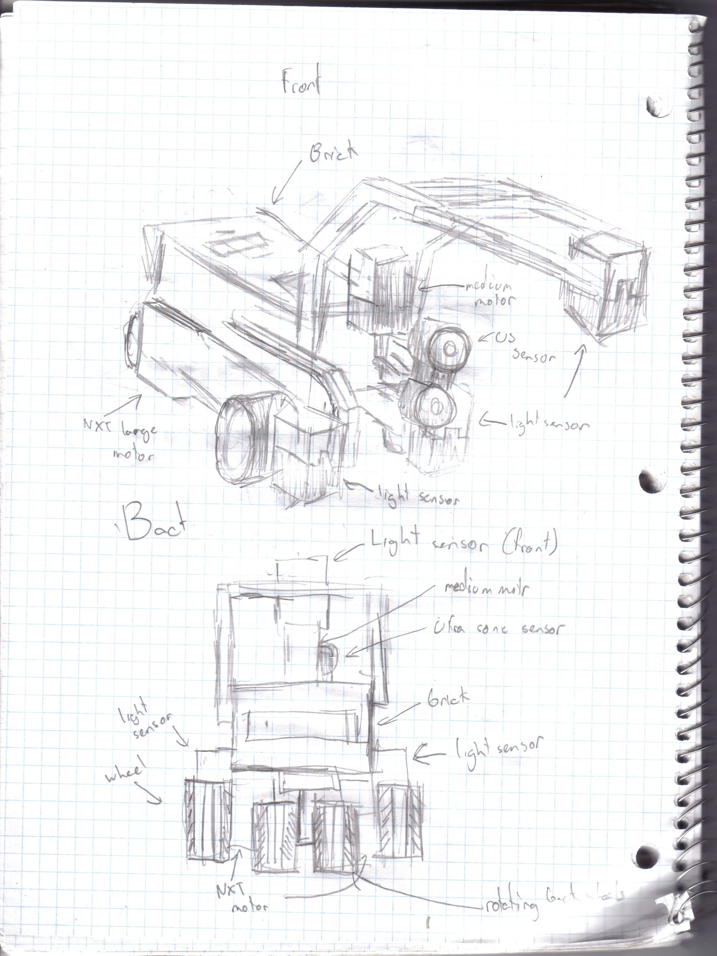
Preliminary Hardware Design #3
Key Features
Robot will be programmed such that half of the robot will travel on water while the other half will travel on the bridge.
Two light sensors in front of both corners of the robot. Allows for better odometer correction.
Variable Ultrasonic sensor for detection of blocks on multiple sides of the robot.
Colour detecting light sensor is always 11 cm off the ground allowing for more consistent readings.
Key Parts
3 light sensors
1 ultrasonic sensor
2 large EV3 motors
1 medium EV3 motor

Slide 15
Preliminary Software Design
Several classes reused from the labs: Odometer, Navigation, Localization, with adaptations to the new requirements.
Addition of a Robot class to manage constants and instance variables, to centralize the data.
Main CaptureTheFlag class sets the Robot’s instance variables, launches threads and acts as scheduler for all operations.

Slide 16
Preliminary Software Design
Search procedure not yet finalized. Testing needs to be done to assess all options.
Localization needs improvement in speed and efficiency.
Other simpler classes such as Odometer or ColourCalibration need fine tuning but no major work.

Slide 17
Preliminary Testing Plan
Test Sensors
Test Motors
Test software Plans and Feasibility

Slide 18
Next Steps
Implemented Time sheet
Each team member will mark down his hours and work done
Implement a README for GitHub Commits
Develop Hardware Design
Finalize final Design
Build & Sketch design
Develop Software Architecture
Class Hierarchy, Flow chart

Slide 19
Any Questions?

